Slide 1
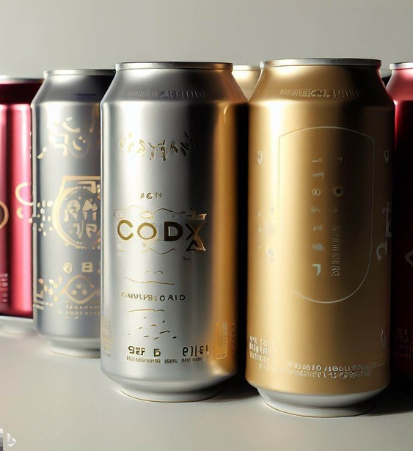
Key Insights from CodeX Energy Drink Survey in India
Presented by:-
Meet Modi

Slide 2
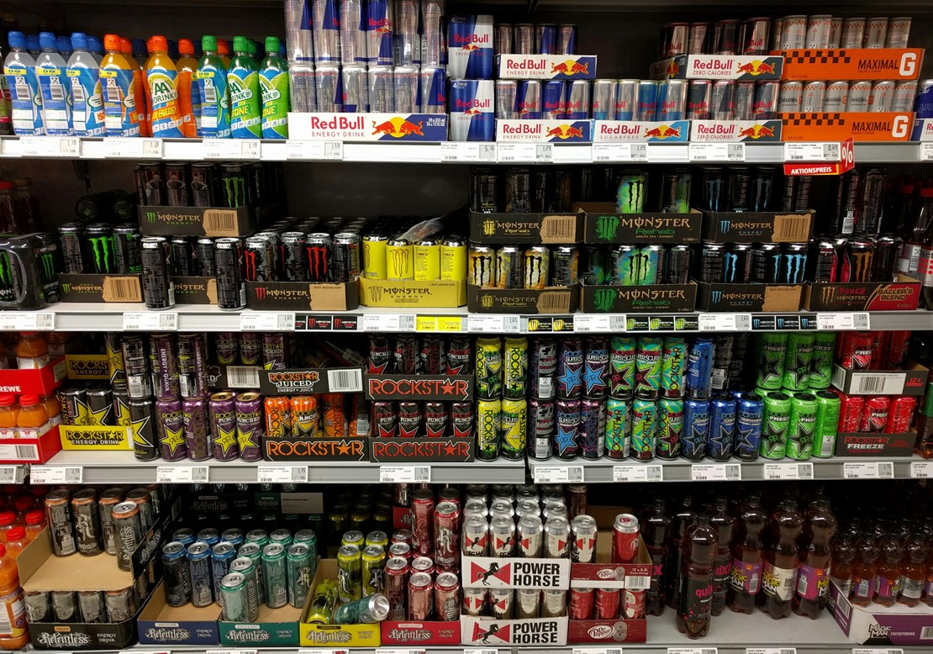
About
Action
Primary Insights
recommendation
Brand ambassador
task
3
4
CONTENTS
5
6
21
29

Slide 3
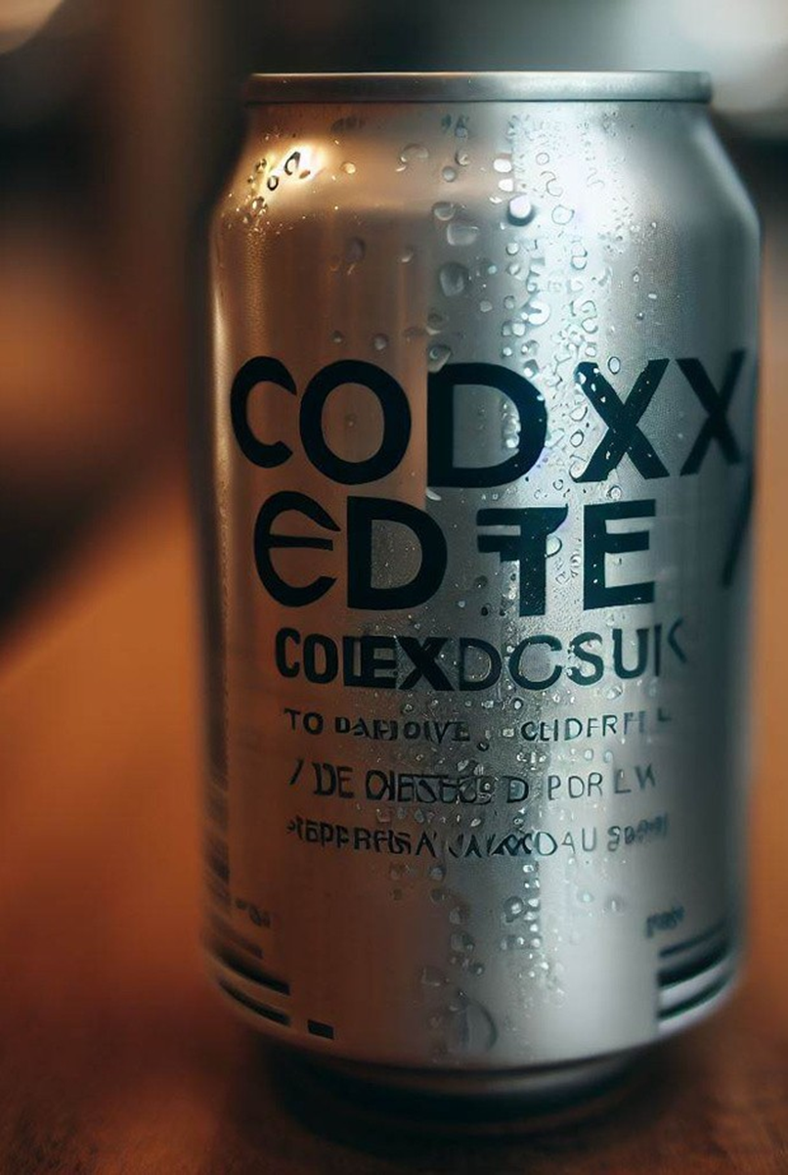
about
CODEX, a German beverage company, recently launched its energy drink in 10 cities in India and is aiming to make in the Indian market.
The Marketing team’s objectives include increasing brand awareness, market share and product development
.
To gather insights, a survey was conducted in the 10 cities, generating responses from 10,000 respondents.
The aim is to provide meaningful insight’s and recommendations that align with Codex’s and drive success in the Indian market.

Slide 4
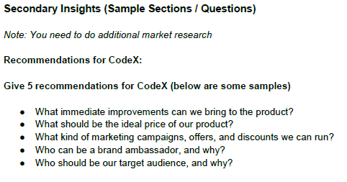
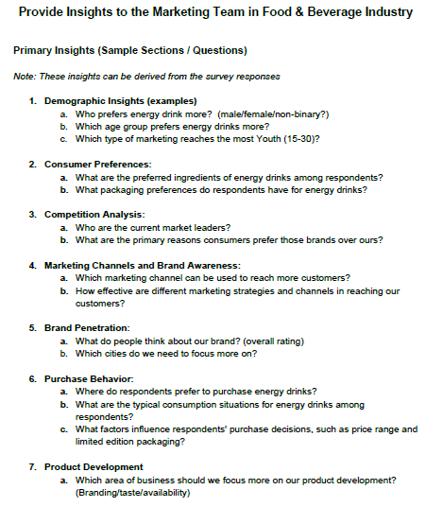
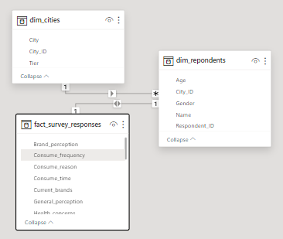
task
The task to extract meaningful insights that can guide actionable strategies and decisions for the Marketing team and present it to the Chief Marketing Officer

Slide 5
Action
Increase Awareness: Enhance advertising, social media, and PR efforts to boost Codex energy drink's visibility among the target audience.
Expand Distribution: Forge partnerships with retailers and distributors for wider availability of Codex energy drink.
Promotional Campaigns: Offer attractive discounts and promotions to entice consumers to try Codex.
Product Innovation: Introduce new flavors and innovative packaging to cater to diverse consumer preferences.
Market Research: Regularly conduct market research to track performance, gather feedback, and identify growth opportunities.

Slide 6
PRIMARY INSIGHTS
Demographic Insights
Consumer Preferences
Competition Analysis
Marketing Channels and Brand Awareness
Brand Penetration
Purchase Behavior
Product Development

Slide 7

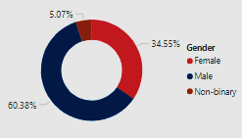
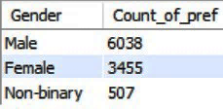
DEMOGRAPHIC INSIGHTS
Who prefers energy drink more? (male/female/non-binary?)
The Survey was conducted on 10,000 people . In this it was found that preference of energy drink were higher in Males in comparison to Females.
On an Average 60% Males consumes more energy drinks while their were only 35% Females who likes to consume energy drink.

Slide 8
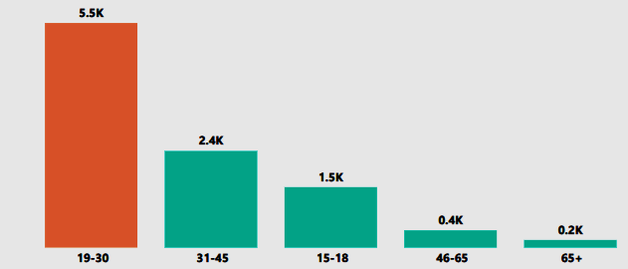
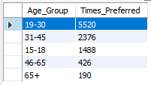
Which age group prefers energy drinks more?
Youngster between age group 19 to 30 exhibit a high preference of energy drink. Around 55.2% of this age group consume more energy drink to comparison to other age group.
The Company has the opportunity to target the 19 to 30 Age Group as their primary audience, which can greatly contribute to Increasing Sales.

Slide 9
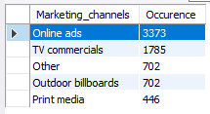
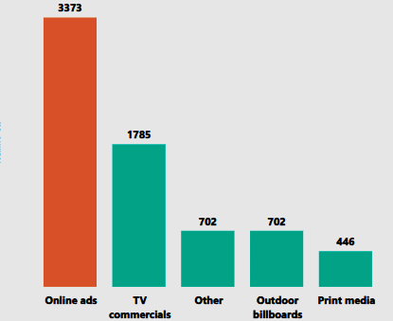
Which type of marketing reaches the most Youth (15-30)?
Online Advertising Marketing reaches to the most youth ( 15 to 30 ).
Youngsters are more active socially that’s why marketing things online is the most effective way to reach youth.
The Company has a significant opportunity to capture attention of all by increasing frequency of their commercial Advertisements on television channels especially when introducing New Offers.

Slide 10

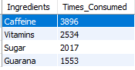
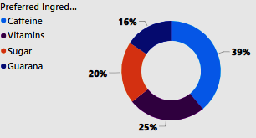
CONSUMERS PREFERENCES
What are the preferred ingredients of energy drinks among respondents?
According to Survey, Caffeine was the most preferable ingredient by the respondents . Around 39% of total respondent like Caffeine than other ingredient.
The Marketing team can leverage Caffeine’s popularity by highlighting its benefits.

Slide 11
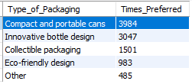
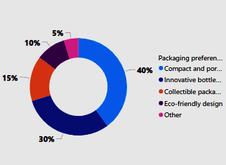
What packaging preferences do respondents have for energy drinks?
Compactable And Portable Cans were most preferred option by the respondent. Around 40% people prefer smaller and easily transportable cans. Innovative Bottle Design were followed closely by 30%
Reason why consumers prefer cans for Energy drinks are portability, durability, and reseal ability.

Slide 12
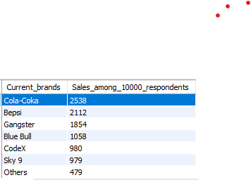
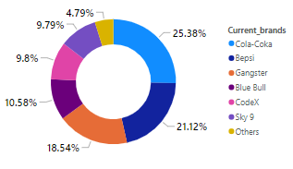
COMPETITIVE ANALYSIS
Who are the current market leaders?
The survey shows that the top three current market leaders are Cola-Coka, Bepsi and Gangster respectively.
Cola-Coka is on the top with 39% respondent shows interest in consuming this brand’s energy drink.
While Codex and Sky 9 are on the similar place with 9.8 % respondent interest.

Slide 13
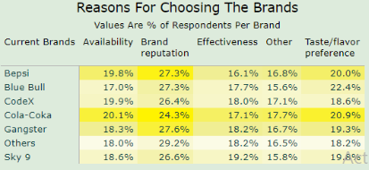
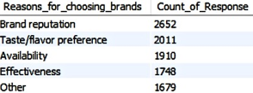
What are the primary reasons consumers prefer those brands over ours?
There are so many reason for choosing a brand . In which some primary reason are :-
Brand Reputation plays a major role in choosing a brand. 26.52% people choose energy drink for consuming because of the energy drink brand’s Reputation.
For which purpose people are consuming energy drink plays an important role in choosing the brand and effectiveness of the energy drink also important for choosing it to consume.

Slide 14


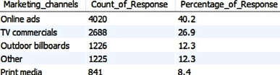
Marketing Channels and Brand Awareness
Which marketing channel can be used to reach more customers?
Online Ads marketing are the most effective ways to reach out the customers, it is highly effective marketing channel that can help business reach a large a large audience and connect with more potential customers as you can clearly see in the visuals.
t
m
e
n
d
i
i
r
a
P
h
t
e
O
r
841
1225
n
e
i
l
a
O
n
d
s
m
m
e
o
r
c
c
i
V
a
T
l
s
4020
2688
b
r
i
l
o
l
o
b
d
o
t
a
u
r
O
d
1226
s

Slide 15



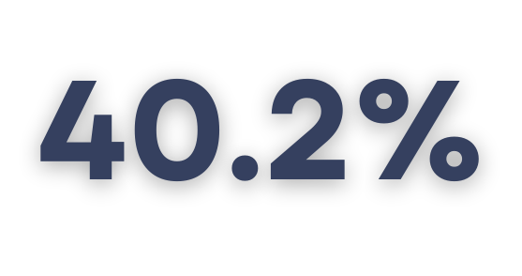
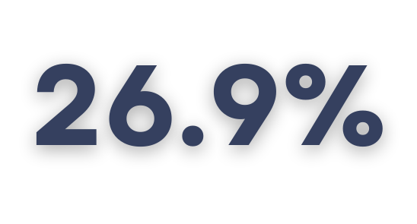


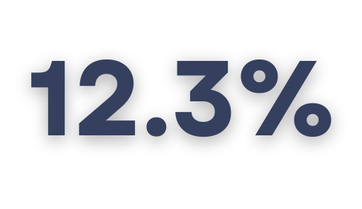
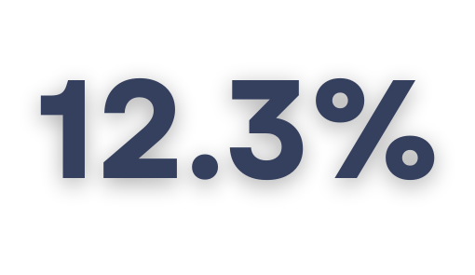
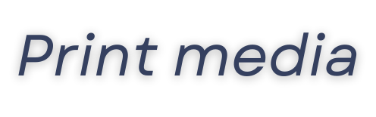
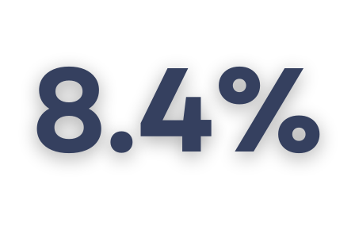
How effective are different marketing strategies and channels in reaching our customers?
Online ads are the most effective marketing strategy for reaching customers for Codex energy drink. This is because online ads can be
targeted to specific demographics, such as young adults who are likely to consume energy drinks.
Online ads can also be tracked to see how effective they are in driving traffic to the Codex website or generating sales.
TV commercials are the second most effective marketing strategy for reaching customers for Codex energy drink. This is because TV commercials can reach a large audience and are often seen by people who are already interested in energy drinks.TV commercials can also be used to create brand awareness and generate excitement for Codex energy drink.

Slide 16
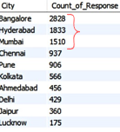
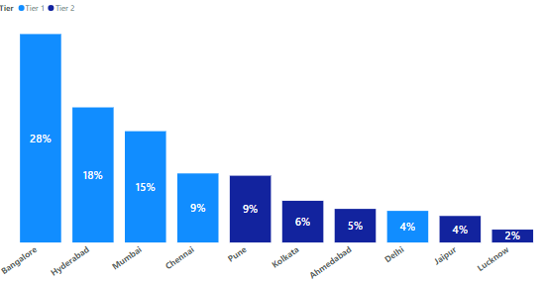
Brand PENETRATION
Which cities do we need to focus more on?
Bangalore, Hyderabad and Mumbai exhibit the Highest response rate indicating a larger potential market for CodeX.
Chennai and Pune also shown significant response numbers, making them valuable market regions to target.
Marketing efforts should prioritize these cities to maximize brand exposure and tap into their potential customer base.

Slide 17


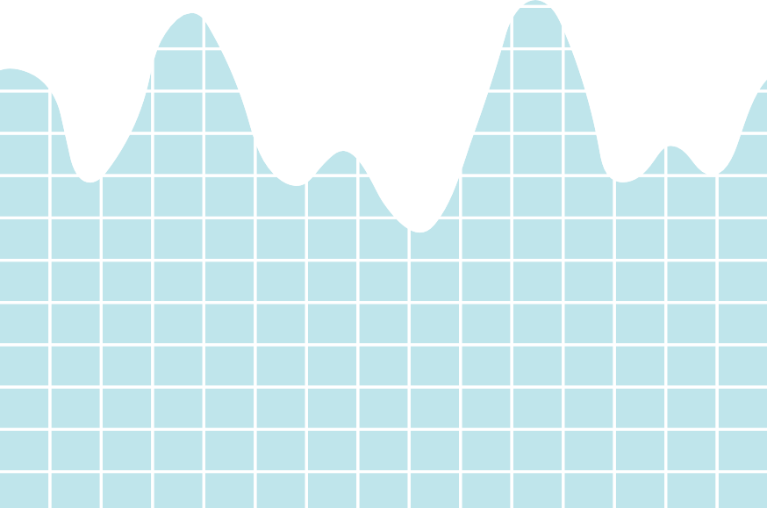
What do people think about our brand? (overall rating)
Out of 980, 455 people have heard about our brand and hence we consider their ratings for the CodeX product taste. This rating of 3.3 is the industry avg rating as well.
A V E R A G E R A T I N G
10000
44%
CodeX
2
3
6
Heard about Codex
4447
4
5
Tried CodeX Drink
2026
386 511
620
300 209
20%
5
4 3 2 1

Slide 18
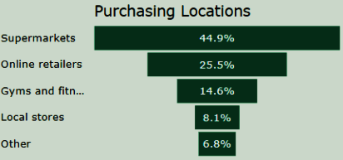
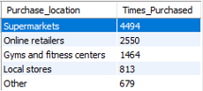
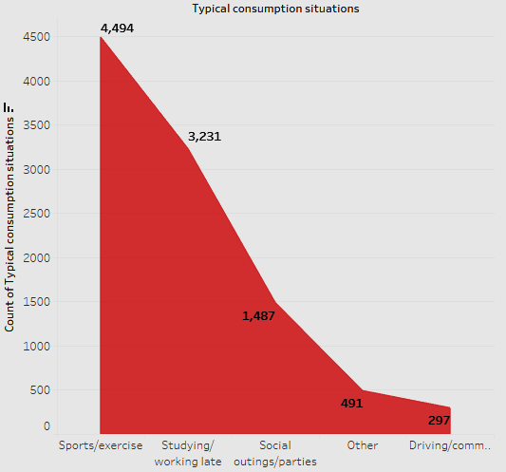
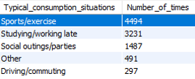
PURCHASE BEHAVIOR
Where do respondents prefer to purchase energy drinks?
Most of respondent purchasing location were Supermarkets 45% of respondent bought energy drink from Supermarket . After Supermarket online retailers comes on the second place with 26% respondent in purchasing location
What are the typical consumption situations for energy drinks among respondents?
Sports/Exercise is on top for consuming energy drink with 4500 respondent. 45% of respondents consuming energy drinks to boost energy level of their Sport/Exercise activities

Slide 19
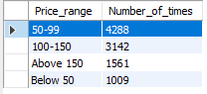
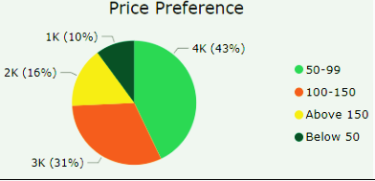
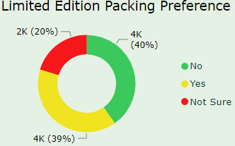
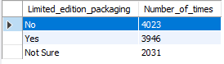
What factors influence respondents' purchase decisions, such as price range and limited edition packaging?
43% of the consumers buy a product if the price is between 50-99.
40% of the consumers do not expect a change in the packaging while 39% of consumers are open to trying the Limited Edition Packaging.

Slide 20
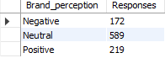
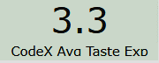
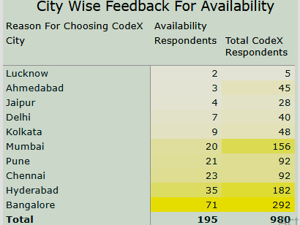
PRoduct development
Which area of business should we focus more on our product development? (Branding/taste/availability)
Out of 980 respondents of Codex, only 219 have a positive brand perception
The taste experience rating is the same as the industry rating. This is not something that needs immediate attention
We need to work on the Availability of the product. About 20% of the consumers choose the product because it is available. Availability is a major factor in sales of a product

Slide 21
recommendation
What immediate improvements can we bring to the product?
A v a i b i l i t y
H e a l t h B e n e f i t s
F l a v o u r E n h a n c e m e n t B r a n d C o m m u n i c a t i o n

Slide 22
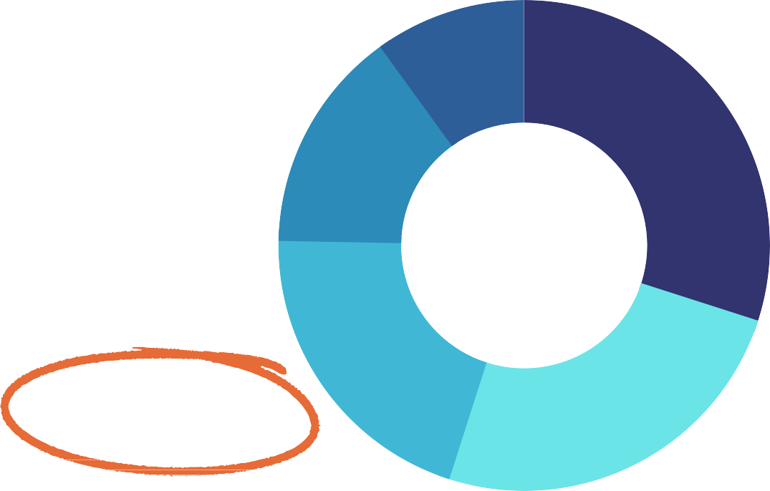
What immediate improvements can we bring to the product?
A v a i b i l i t y
Among the 4,447 people who heard about CodeX, a significant portion of 2,421 individuals (54.4%) didn't try the product.
Notably, 22.3% of respondents mentioned that the product's unavailability locally was a key factor in their decision not to try CodeX.
Availability emerged as one of the top three reasons influencing people's choice of a particular brand among market competitors.
To address this, we should prioritize assessing the product's distribution and supply chain. Ensuring that CodeX is easily accessible in key markets and popular retail outlets is essential to meet customer demand and drive adoption.
Other 10%
Not interested in energy drinks 23.6%
Unfamiliar with the brand 21.3%
Not available locally 22.3%
Health concerns 22.7%

Slide 23



What immediate improvements can we bring to the product?
H e a l t h B e n e f i t s
Other 10%
Lower sugar content or utilizing natural sweeteners like stevia or honey.
Using natural ingredients, to avoid artificial additives, sweeteners, and preservatives.
Enhancing nutritional value by incorporating vitamins, minerals, and antioxidants.
Controlling caffeine levels for a boost without excessive stimulation.
Choosing natural coloring from fruit or vegetable extracts, to avoid artificial colors.
Clearly labelling ingredients and nutritional information for informed choices.
Developing low-calorie variants to cater to health- conscious consumers.
Combining energy benefits with hydration to promote overall wellness
Reduced sugar content 30%
Healthier alternatives 14.7%
Wider range of flavors 20.4%
More natural ingredients 25%
6045 Have Health Concerns
4983 Preferred Natural Energy Drink

Slide 24
What immediate improvements can we bring to the product?
F l a v o u r E n h a n c e m e n t
Let's use natural flavors to appeal to consumers seeking natural ingredients.
Create unique flavors to stand out in the competitive market.
Offer low-sugar options with sweeteners like stevia or monk fruit.
Adjust acidity for a more balanced and enjoyable taste.
Use carbonation in moderation for a refreshing flavor experience.
Other 10%
Reduced sugar content 30%
Healthier alternatives 14.7%
Wider range of flavors 20.4%
More natural ingredients 25%

Slide 25
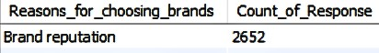
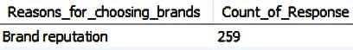
What immediate improvements can we bring to the product?
B r a n d C o m m u n i c a t i o n
Let's clarify our brand identity and values, communicating what sets us apart and what we want to stand for.
Craft a strong and concise brand message that resonates with our target audience and leaves a lasting impression.
Consistency is vital; maintain the same message across all marketing channels, including our website, social media, advertising, and packaging, to build recognition and trust.
Embrace authenticity and transparency in our communications to build trust with customers and showcase our genuine brand values.
Engage actively with our audience on social media, online forums, and in- person interactions to forge meaningful relationships and gain valuable insights into their needs and preferences. This will help us better serve and connect with our customers.
9.8%

Slide 26
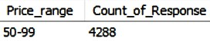
What should be the ideal price of our product?
₹119 for a 250 ml compact and portable can.
Considering-
Price sensitivity: Indian consumers are generally price-sensitive, so they are more likely to purchase energy drinks that are priced affordably.
Product Quality: Indian consumers are increasingly demanding high- quality products, so energy drinks that are made with high-quality ingredients and offer a good value for money are more likely to be successful.
Below 50
10.1%
Above 150
15.6%
50-99
42.9%
100-150
31.4%

Slide 27
What kind of marketing campaigns, offers, and discounts we can run?
Free samples
Partnerships
Discounts
Referral programs
Partnerships
Sweepstakes and contests
CodeX Feast
Opportunity: Organizing a Codex Feast would be a great opportunity to gather a large crowd of people and introduce them to the variety of flavors and tastes of Codex energy drink. This would help to grow brand communication and create a one-on-one relationship with consumers.
Target audience: The target audience for the Codex Feast would be young adults between the ages of 16 and 35. This is the demographic that is most likely to consume energy drinks.
Location: The Codex Feast could be held in Bangalore, which is a major city in India with a large population of young adults.
Benefits : The CodeX Feast would offer a number of benefits for the brand ,including:
Increased Brand Awareness
Increased Sales
Enhanced Customer Loyalty
Positive Word of mouth
The event could feature live music, games, and other activities to entertain guests. Codex could partner with other brands to offer discounts or promotions at the event. The Codex Feast could be live-streamed on social media to reach a wider audience.

Slide 28
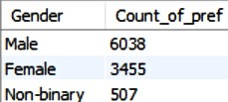
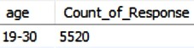
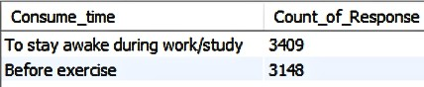
Who should be our target audience, and why?
Target audience: Young adults aged 19-30 (5520), with significant representation from males (6038)
and females (3455).
Focus: Those seeking energy for work/study (3409) and before exercise (3148), as well as sports/exercise enthusiasts (4494) and those studying/working late (3231).
Benefits: Emphasize increased energy and focus (3574) as the primary product benefits.
Strategy: Direct marketing efforts towards these key segments to boost brand awareness and drive product adoption in the market.
Other 4.9%
Social outings/parties 14.9%
Sports/exercise 44.9%
3,000
Studying/working late 32.3%
2,000
1,000
Increased energy and focus
To combat fatigue
To enhance sports performance
To boost performance
Other

Slide 29
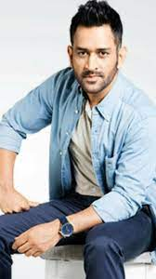
Who can be a brand ambassador, and why?
M. S. Dhoni
Age: 42 years Sport: Cricket
MS Dhoni is a role model who has shown everyone the value of hard work and how one can achieve everything if one is dedicated enough to their goals.
He is a wicket-keeper and batsman in professional international cricket
He served India as a captain in all three cricket formats from 2007 to 2017. He is the only captain for India to have won three ICC tournaments.
MS Dhoni has now retired from all three formats, but continues to play for an Indian cricket franchise Chennai Super Kings in the Indian Premier League and has won five trophies since 2008.
MS Dhoni is famous for his cool performance on the pitch, because of which he has won multiple prestigious awards. He also received the prestigious Padma Bhushan and the honorary rank of Lieutenant Colonel for his contribution in the field of cricket.
He is a great role model for young adults who are looking for inspiration and motivation. M.S. Dhoni has a large following on social media, with over 47 million followers on Instagram, which means that he would be able to reach a large audience with her marketing campaigns.
He is an active and engaging social media user, which means that he would be able to build relationships with her followers.

Slide 30


T H A N K YO U
How to rich me ?
Mail modimeet1074@gmail.com
www.linkedin.com/in/meetmodi369

